Slide 1
P2P Networking System
RustamoVa Malikakhon
12230035

Slide 2
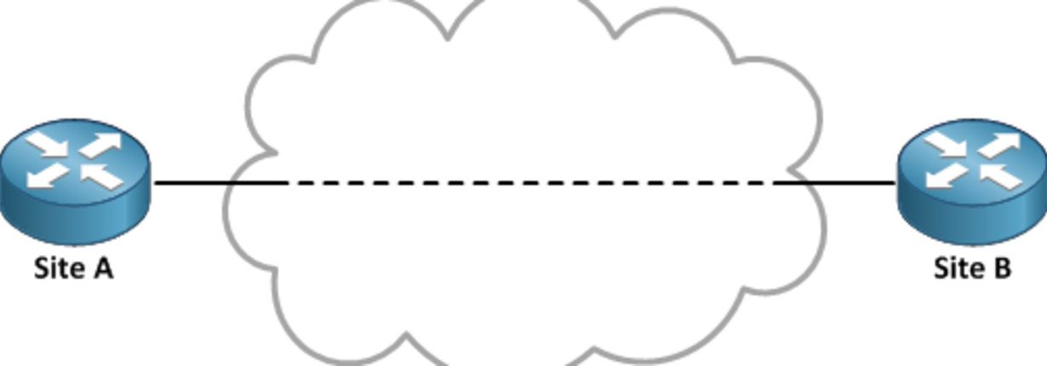
About P2P Network connection
A peer-to-peer (P2P) network connection is a decentralized form of communication where nodes, or peers, can act as both clients and servers. P2P networks have no central server and rely on direct node-to-node communication. Key aspects include decentralization, dynamic network topology, resource sharing, scalability, and security challenges. P2P networks are used for file sharing, decentralized cryptocurrencies, and peer-to-peer messaging. The specific implementation and features can vary depending on the protocol or application used.

Slide 3
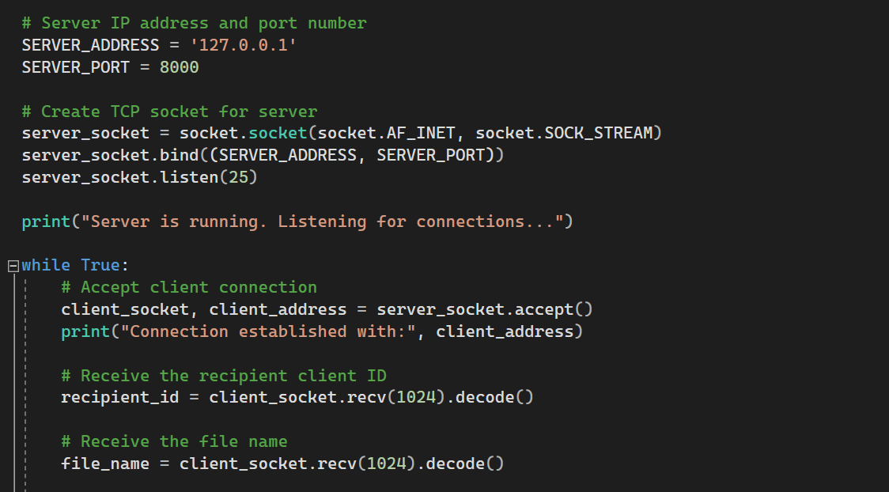
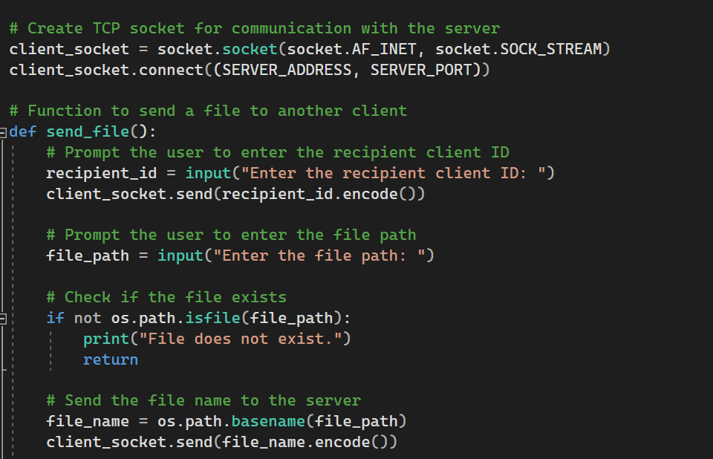
Sending and visualizing the image, CSV, and JSON files
Server side
Client side

Slide 4
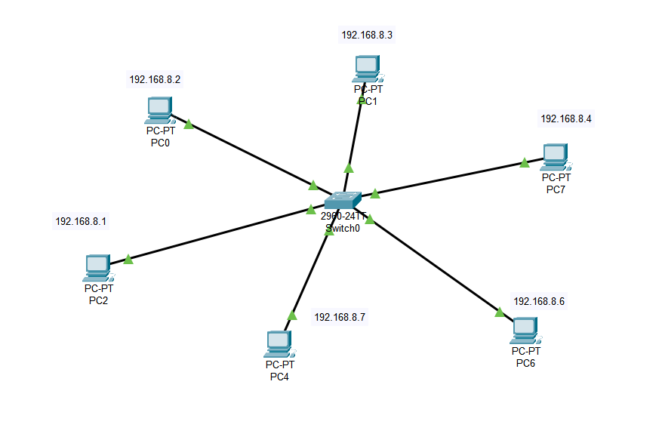
Cisco Packet Tracer

Slide 5
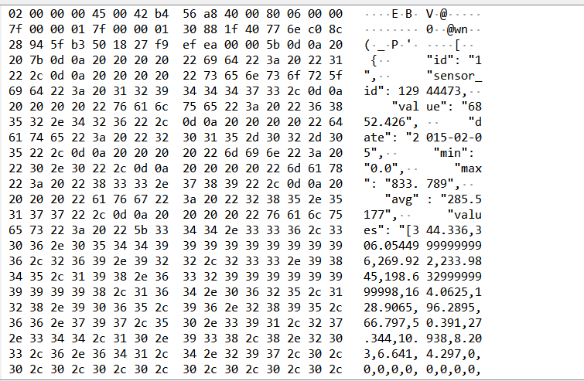
Wireshark Examples

Slide 6
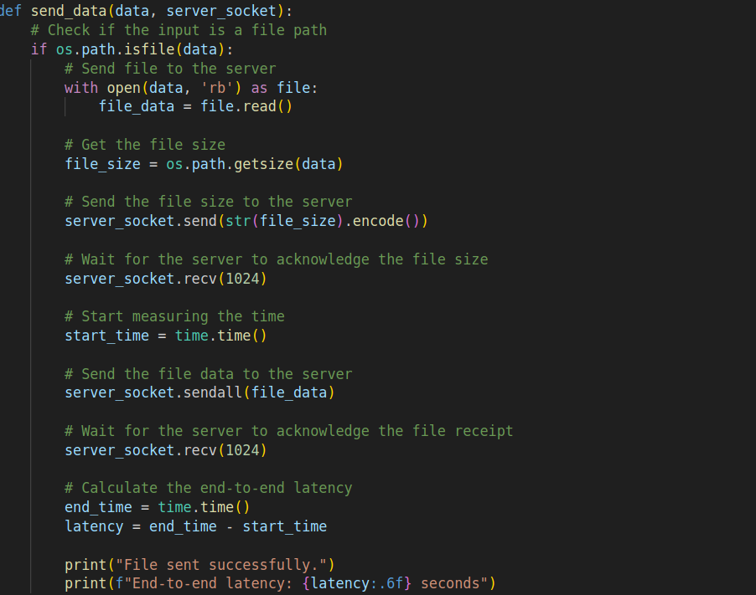
Calculating the latency

